Slide 1


Slide 2
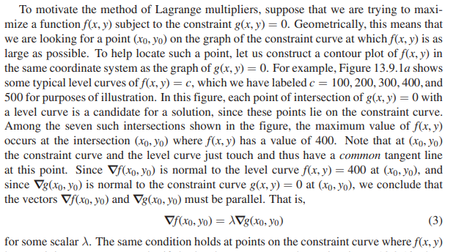

Slide 3
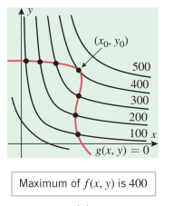

Slide 4
We will say that f has a constrained absolute maximum (minimum) at (x0, y0) if f(x0, y0) is the largest (smallest) value of f on the constraint curve, and
we will say that f has a constrained relative maximum (minimum) at (x0, y0) if f(x0, y0) is the largest (smallest) value of f on some segment of the constraint curve that extends on both sides of the point (x0, y0)

Slide 5
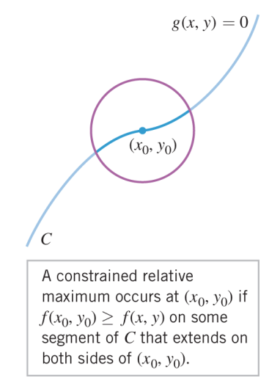

Slide 6
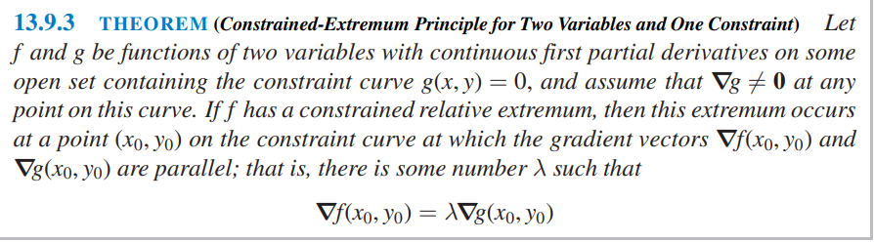

Slide 7
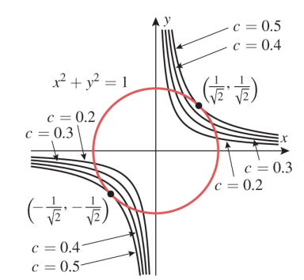

Slide 8


Slide 9
We will say that f has a constrained absolute maximum (minimum) at
(x0, y0,z0) if f(x0, y0,z0) is the largest (smallest) value of f(x, y, z) on S, and we will say that f has a constrained relative maximum (minimum) at
(x0, y0,z0) if f(x0, y0,z0) is the largest (smallest) value of f(x, y, z) at all points of S “near” (x0, y0,z0).

Slide 10
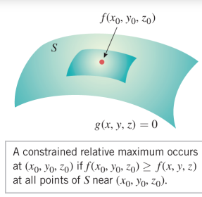

Slide 11
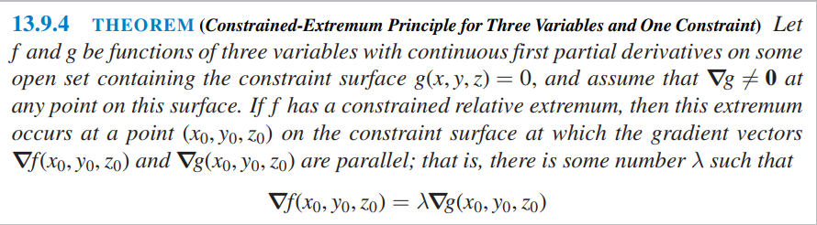

Slide 12
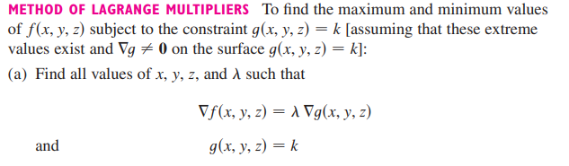


Slide 13


Slide 14
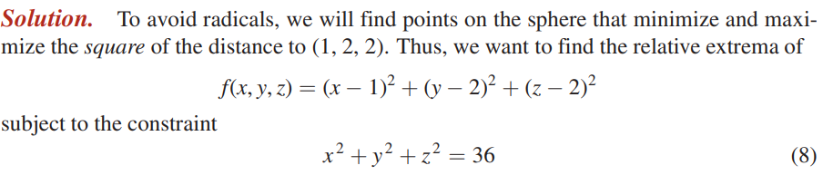

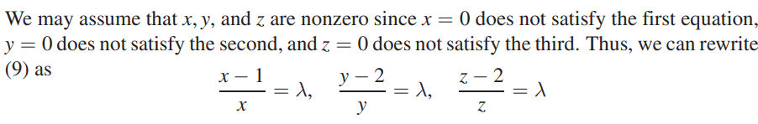

Slide 15
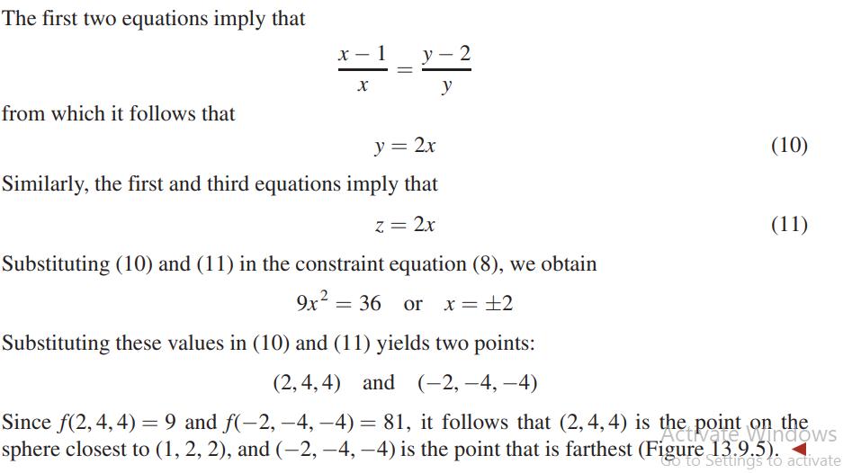

Slide 16
